Slide 1

AI STUDY PLANNER
PRESENTED BY:
23RH5A6616 M.Sruthi
23RH5A6619 T.Anusha
23RH1A6640 B.Laxmi
24RH5A6635 B.Anusha

Slide 2
Introduction
An AI study planner is an intelligent tool designed to help students and professionals organize their study schedules efficiently. By analyzing learning patterns, priorities, and deadlines, it creates personalized study plans that optimize time management and productivity. AI-powered planners can suggest study sessions, break down complex topics, and adjust schedules dynamically based on progress. They also integrate reminders, goal tracking, and resource recommendations to enhance learning. With features like adaptive learning and real-time updates, an AI study planner ensures a structured and effective approach to achieving academic or professional goals.

Slide 3
Problem Statement
Students and professionals often struggle with managing their study schedules effectively due to shifting priorities, varying learning speeds, and external constraints. Traditional planning methods, such as paper-based schedules or static digital calendars, lack the flexibility to adapt to these challenges. An AI-powered study planner can solve this problem by intelligently creating and adjusting study schedules based on factors like subject difficulty, deadlines, available time, and learning patterns. This system would provide dynamic scheduling, real-time adjustments, performance tracking, and personalized reminders to enhance productivity. Additionally, integrating AI-driven techniques such as spaced repetition and progress analysis can optimize retention and efficiency. By offering multi-platform access and smart insights, an AI study planner can help learners stay organized, maximize study effectiveness, and achieve their academic or professional goals

Slide 4
Proposed System
The proposed system is an AI-powered study planner designed to create, manage, and optimize study schedules based on user-specific needs and learning patterns. It will feature an intelligent scheduling algorithm that considers subject difficulty, deadlines, available time, and personal preferences to generate an optimized study plan. The system will use adaptive learning techniques, adjusting schedules dynamically based on user progress, delays, or unexpected changes.To enhance learning efficiency, the system will incorporate spaced repetition techniques, ensuring timely revision of topics to improve retention. Additionally, it will provide performance tracking and analytics, offering insights into study habits and suggesting improvements. A notification system will send reminders and alerts for upcoming tasks, helping users stay on track.The planner will be accessible across multiple platforms, including web, mobile, and desktop, ensuring seamless user experience and synchronization. AI-driven chatbot assistance will help answer queries, suggest study techniques, and motivate users. Overall, this system will act as a smart personal tutor, adapting to user needs and maximizing study effectiveness.

Slide 5
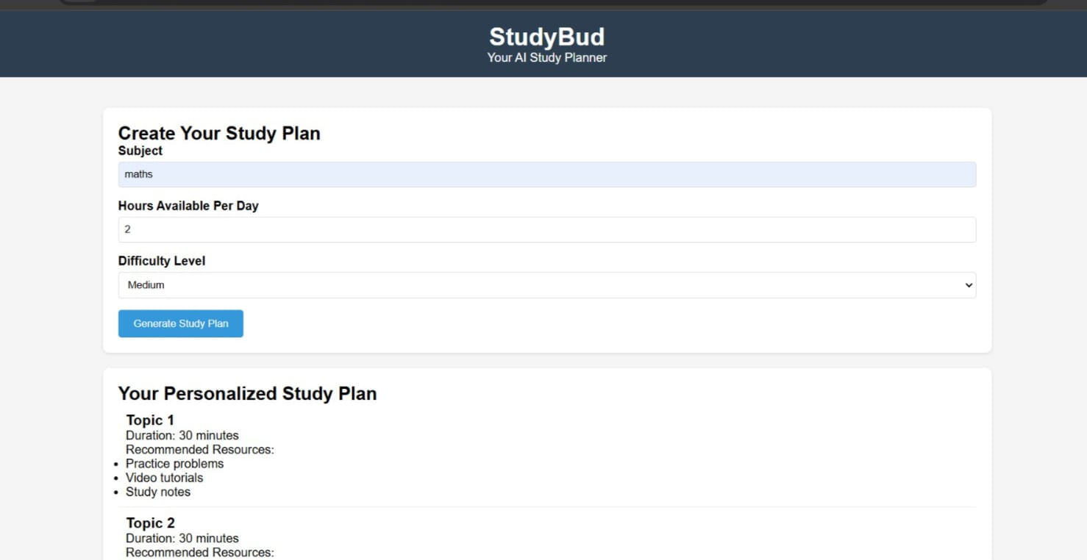
Outcomes

Slide 6
Feature Scope
Feature Scope of AI Study PlannerThe AI Study Planner will have a well-defined feature scope, ensuring adaptability, efficiency, and personalized learning experiences. The scope covers core functionalities, AI-driven features, and user experience enhancements.1. Core FunctionalitiesPersonalized Study Scheduling: Generates custom study plans based on subjects, deadlines, and user preferences.Task Management: Allows users to create, modify, and track tasks such as assignments, exams, and revisions.Progress Tracking: Monitors daily, weekly, and monthly progress with analytics and visual reports.Multi-Platform Syncing: Ensures seamless access across mobile, web, and desktop applications.2. AI-Driven FeaturesAdaptive Scheduling: Adjusts study plans dynamically based on progress, delays, or changes in availability.Spaced Repetition & Memory Retention: Suggests periodic revisions based on learning patterns.Performance Analysis: Provides insights into weak areas, study habits, and efficiency trends.

Slide 7
Conclusion
The AI-powered study planner aims to revolutionize the way students and professionals manage their learning schedules by providing an intelligent, adaptive, and personalized experience. By leveraging AI-driven features such as adaptive scheduling, spaced repetition, performance analysis, and smart recommendations, the system ensures optimized learning efficiency and better retention. With multi-platform accessibility, real-time adjustments, and user engagement features like reminders and gamification, the planner enhances productivity and motivation.This solution not only addresses common study challenges such as poor time management and ineffective revision but also empowers users with data-driven insights to improve their learning outcomes. As a versatile and scalable tool, it can be adapted for various educational needs, from academic study plans to professional skill development. Ultimately, the AI Study Planner serves as a personalized digital tutor, helping users stay organized, focused, and on track toward their learning goals.

Slide 8
THANK YOU!!!

